Slide 1

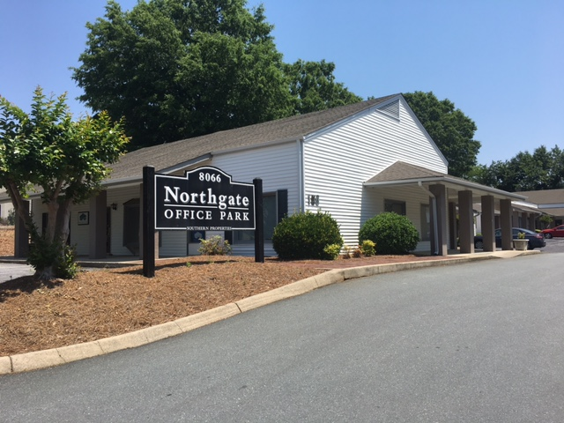
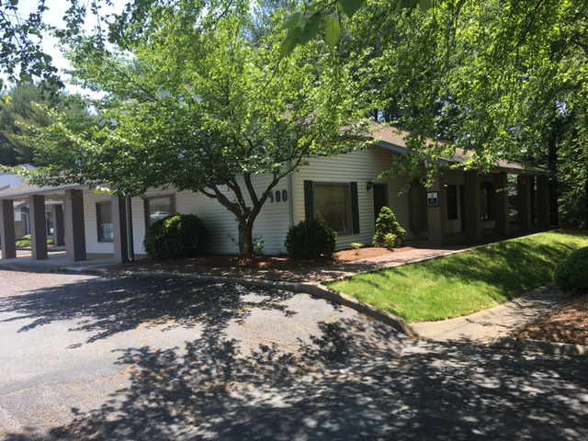
S P A C E A V A I L A B L E
P R O P E R T Y I N F O R M A T I O N
± 500 sq.ft. $650 per month. Power and water included in lease. Located in the Northgate Office Park with easy access to University Parkway, Silas Creek Parkway and Hwy 52. Convenient parking at front entrance with covered side walks. Main Level, one story building. Private Bathroom.
David Southern 336-413-0594
Leaseproperties.com

Slide 2
P R O P E R T Y D E T A I L S
David Southern 336-413-0594
County | Forsyth | Year Built | 1983
Location | 108 Northgate Park Drive, Winston-Salem
Space | 500 sqft available
Utilities | Water, Power (included in rent)
Parking | Curb side, covered walkway parking
Comments | Located in a 5-building office park just off North Point Blvd. All main Level open, studio type space.
Leaseproperties.com

Slide 3
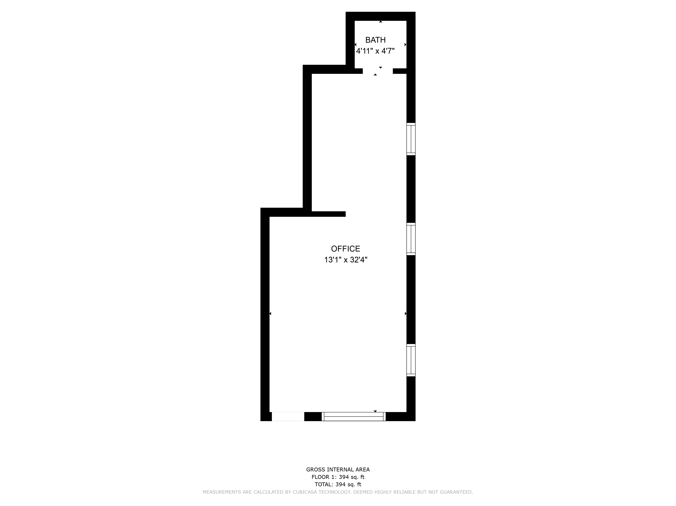
P R O P E R T Y R E N D E R I N G S
David Southern 336-413-0594
Leaseproperties.com

Slide 4
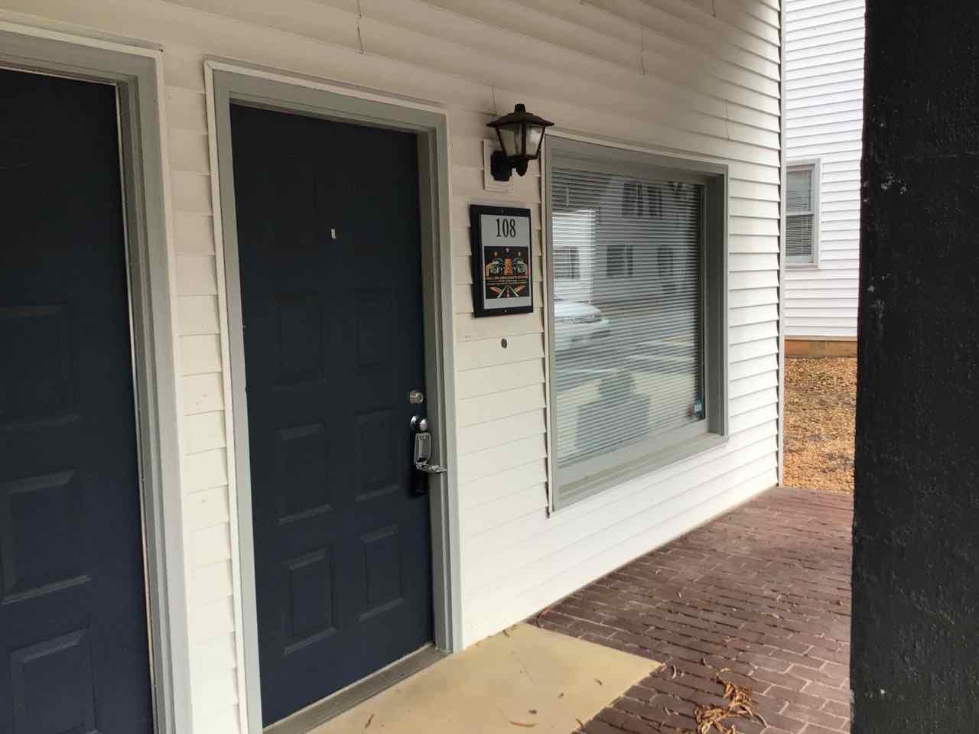
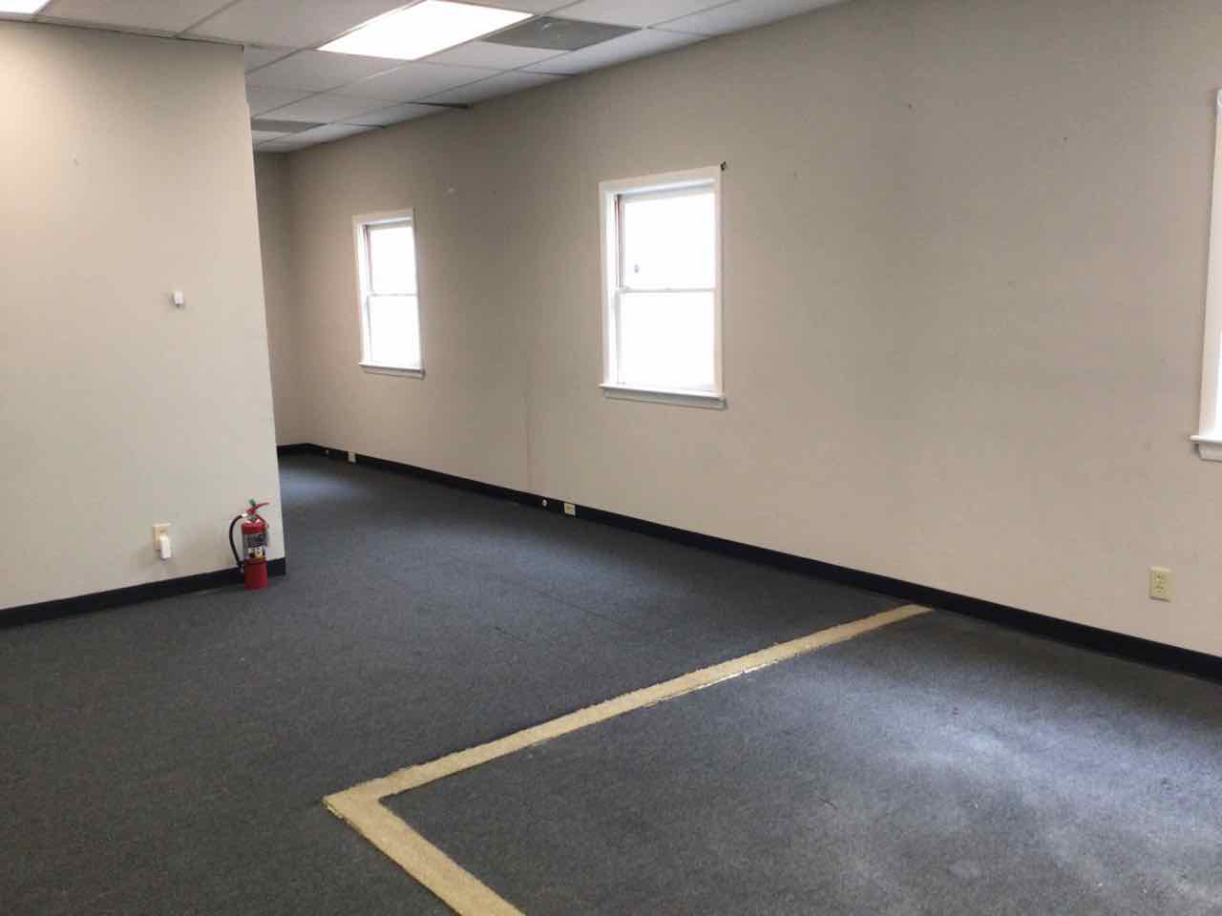
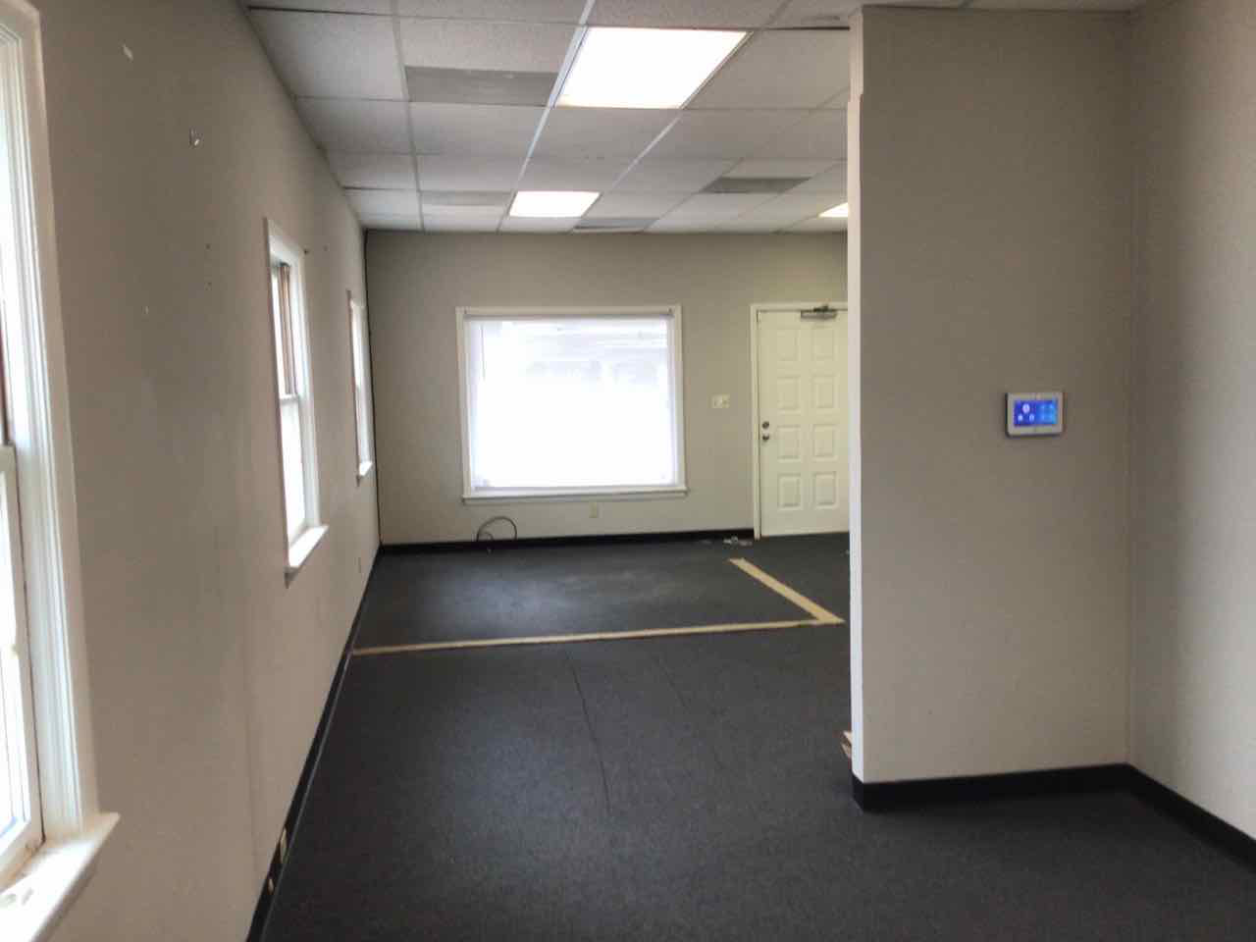
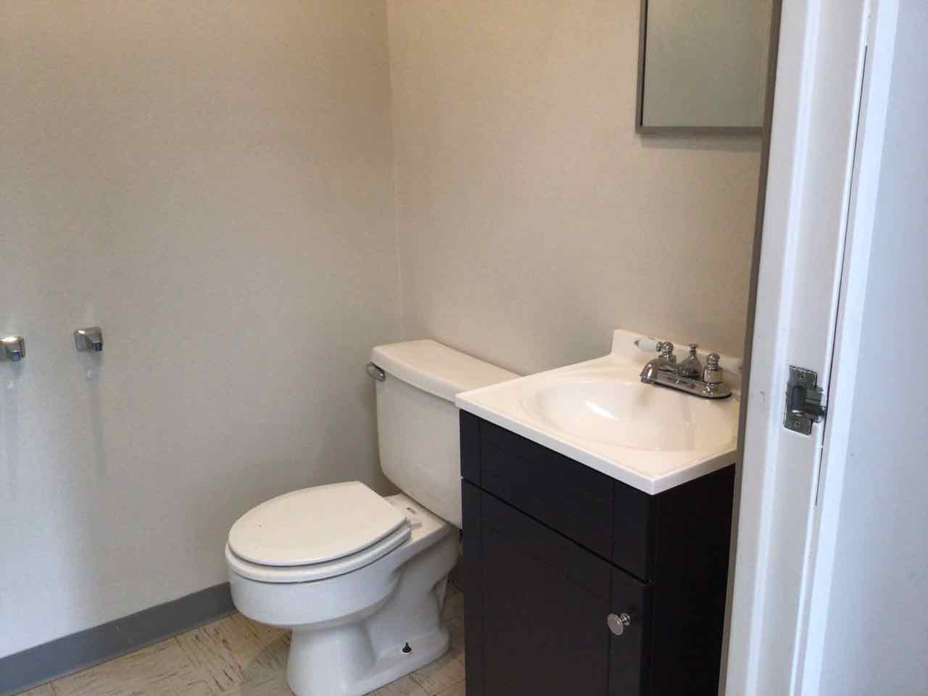

Slide 5
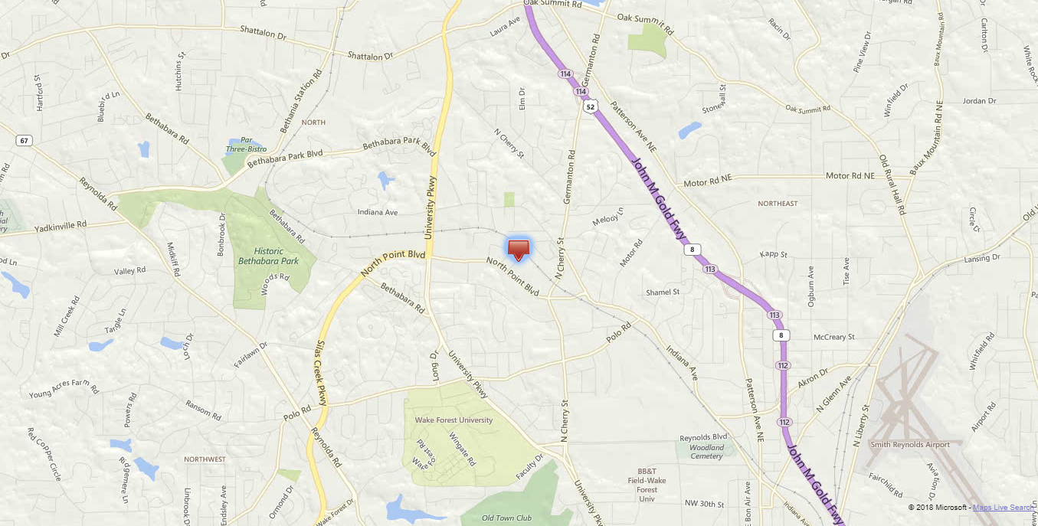
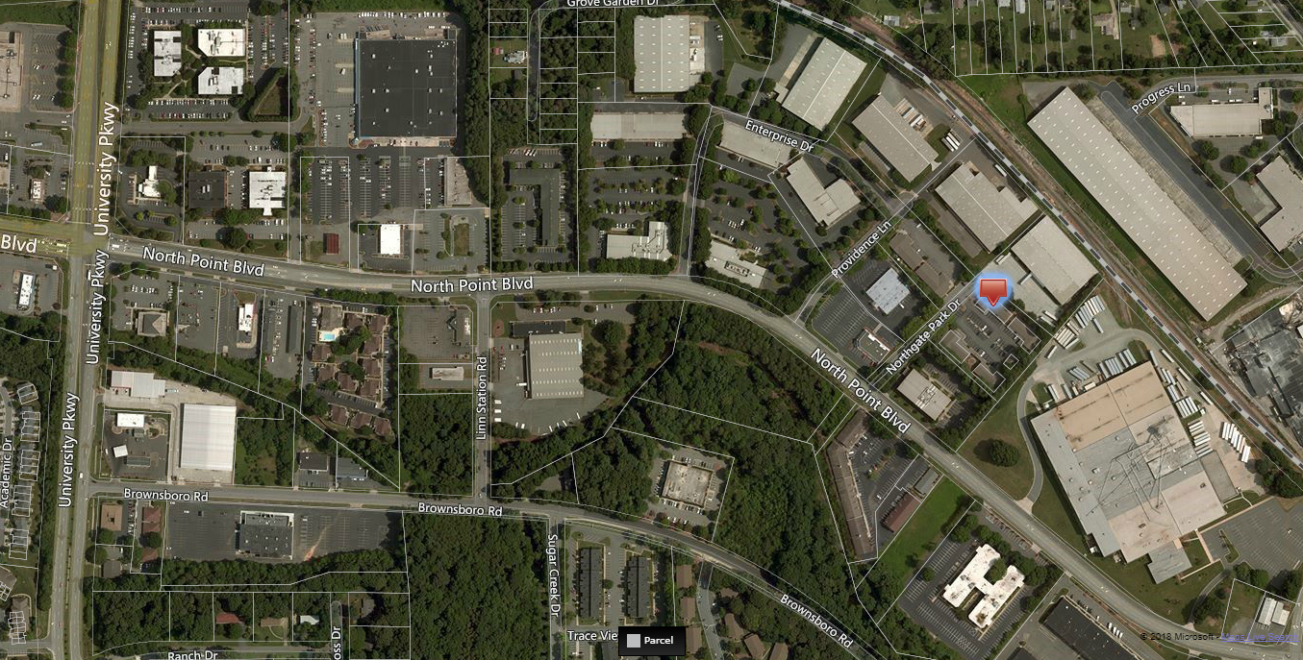
P R O P E R T Y D E T A I L S
David Southern 336-413-0594
Leaseproperties.com

